Slide 1
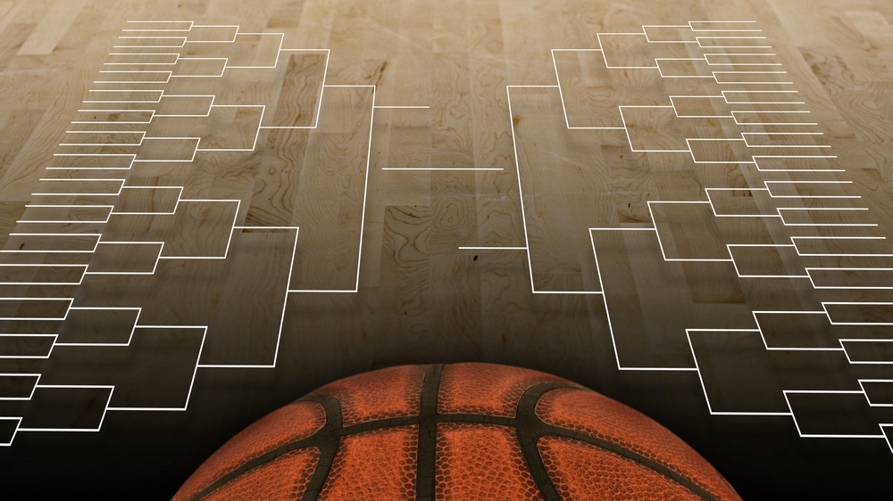
2022 March Madness Predictions
Created by: Annie Titus, Jiebin (Alex) Zhu, Matthew Laken, Zachary Chipman, Farahin Choudhury
IST 718 Final Project

Slide 2
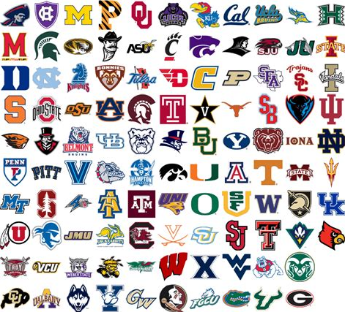
What is March Madness?
The NCAA Division 1 Men's Basketball Tournament, also known as March Madness, is a single elimination tournament played each spring featuring 68 college basketball teams from the Division 1 level to determine the national championship.
Each year, millions of Americans participate in a bracket pool contest. The filling out of a tournament bracket has been referred to as a "national pastime." Filling out a tournament bracket with predictions is called the practice of "bracketology" and sports programming during the tournament is rife with commentators comparing the accuracy of their predictions. Bracketology has become so popular that since 2014, Warren Buffett has offered a $1 million to anyone that can accurately predict the results of the first week games.

Slide 3

Project Question
Q: Can we use data to predict the 2022 winners of the March Madness tournament and determine the final fours region winners and the champion?
But WHY is this question important to us?
Every year, millions of people fill out a bracket for the NCAA tournament with the hope that it is a winning bracket. The actual odds of a perfect bracket — based on a 50/50 shot of each game — is 1-in-9,223,372,036,854,775,808. That's one in nine quintillion.
Not only do we believe this an interesting topic, but we hope by tackling this project, we can provide some data science support behind the decisions of selecting teams paired with the human knowledge of the sport and tournament history to produce a well-rounded bracket, that will showcase a likely percentage that a specific team will win the overall tournament.

Slide 4

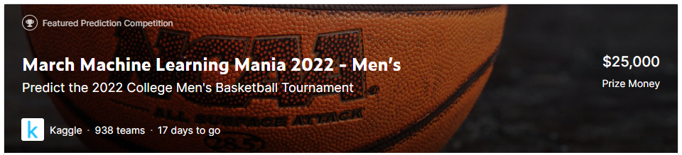
The Datasets and Sources -OBTAIN
The data for all of our Models was taken from the Kaggle competition whose URL is listed here:
https://www.kaggle.com/c/mens-march-mania-2022/data
20 CSVs of men's NCAA basketball data, but our code only uses seven of them:
MTeams: Contains teams current name and assigned TeamID, as well as number of years in the first division.
MNCAATourneySeeds: Identifies the seed for each team in every tournament in the data set.
MRegularSeasonCompactResults and MRegularSeason

Slide 5

How did the data get cleaned?- Data Preparation/SCRUB
NOTE: Most of the source code for data cleaning was found within this link:
https://www.activestate.com/blog/fantasy-march-madness-how-to-predict-winners/
Some important data preparation included:
Normalizing the number of points in game to account for games that go into overtime
Calculating certain metrics such points per game(ppg)/number of games for winning and losing teams/win percentage for the season
Recognizing that there was no tournament in 2020, excluding that year
Doing test/train dataset

Slide 6
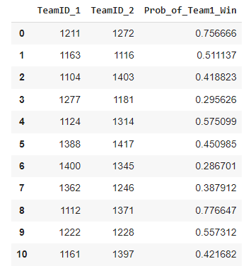
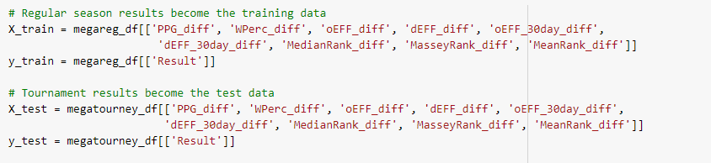
Model - XGBoost
XGBoost stands for eXtreme Gradient Boosting.
Two reasons to use XGBoost: Speed and Performance
Round of 32 Matchups - .083 seconds
Sweet 16 Matchups - .081 seconds
Elite 8 Matchups- .077 seconds
Final 4 Matchups - .075 seconds
Championship matchup -.073 seconds
Tournament Winner - .071 second
Predicted 77% Accuracy Performance

Slide 7
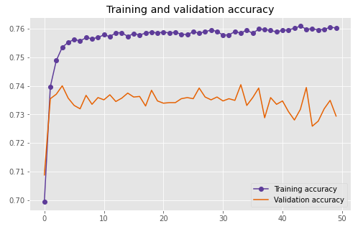
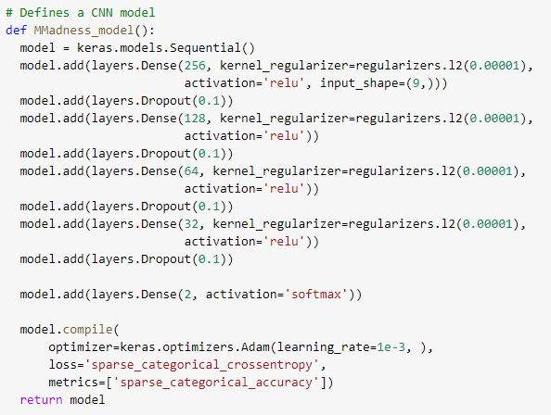
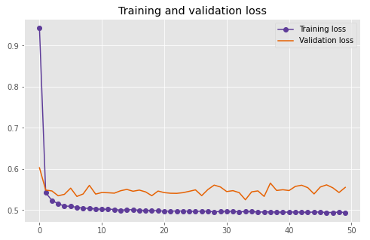
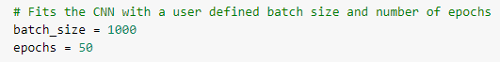
Model – Neural Network
After about 10 passes, the training set flats out at 76%, validation set was about between 73/74

Slide 8
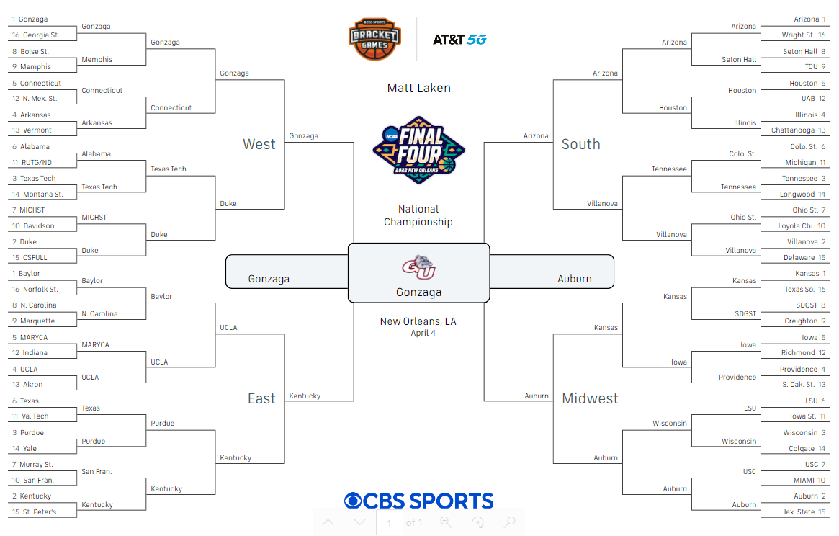
Bracket Recommendation

Slide 9
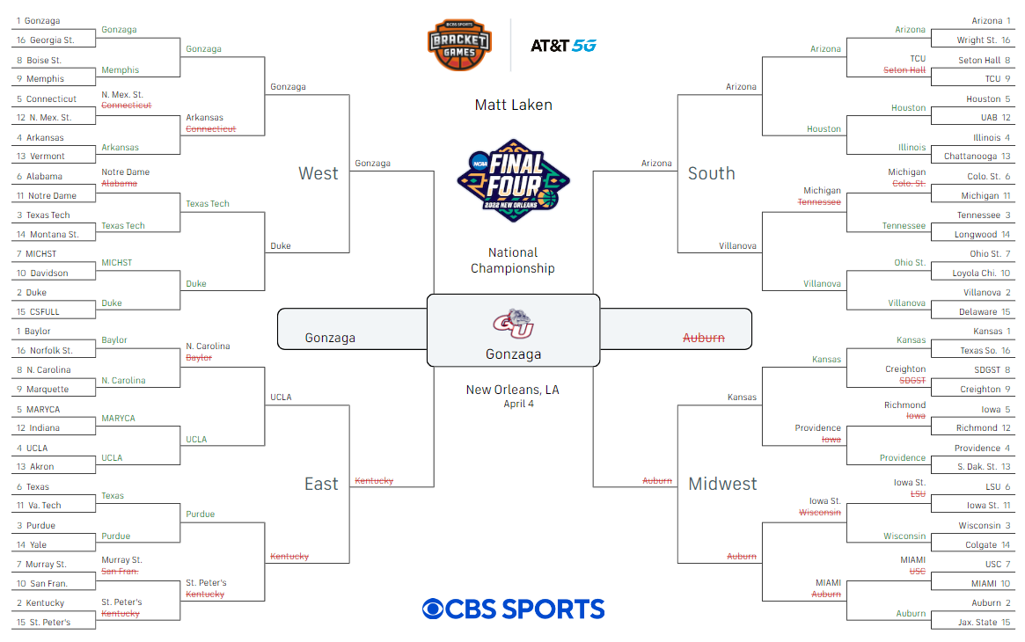
Current Bracket Status

Slide 10


Next Time Recommendations
Use more of the Human Element/intuition in team selection
Using different types of metrics i.e. strength of schedule, seeding, maybe even a ‘luck’ factor
Exploration of more modeling techniques
Boom Shakalaka!

